Slide 1
VE230 Recitation Class 3
by Li Chunchao
2017/10/12

Slide 2
Short Review

Slide 3

Gauss’s law
Electric field line
Electric flux
Gauss’s law

Slide 4
Potential
Potential
Potential energy

Slide 5
Solving Problems

Slide 6
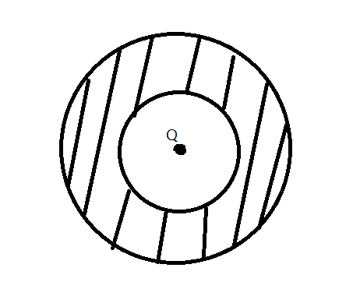
Gauss’s law
There is a point charge Q in a ball conductor with a spherical hole. The center of the ball, the spherical hole and point charge are at same position. Find the surface density of charges on the inner and outer surface of the conductor. The radius of hole is R1 and radius of ball is R2

Slide 7

Gauss’s law
If there is a field $E\left(r\right)=\frac{C}{r^{3}}r$. Find the divergence of $E\left(r\right)$

Slide 8
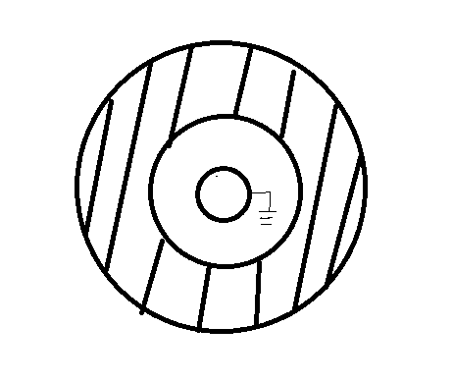
Potential
There is a ball conductor with a spherical hole with charge Q. There is another conductor shell in the center of the hole and connected to the ground. Find the charges on the three surface of the conductor. The radius of hole is R1 and radius of ball is R2 and radius of shell is R3.

